Slide 1

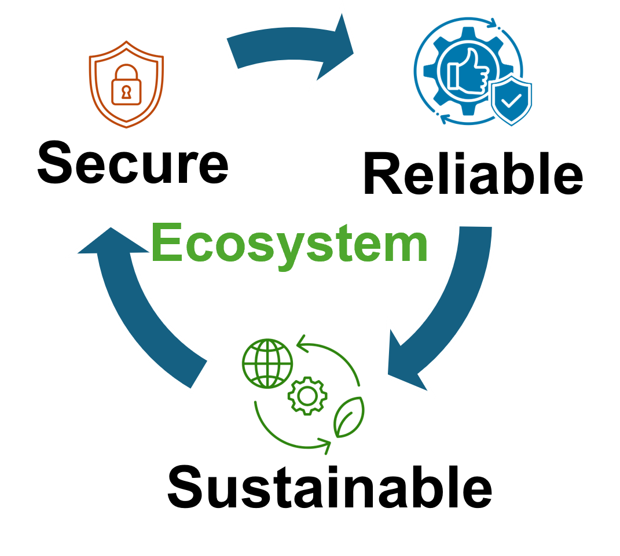


Increasing Teleportation Fidelity using Stabilizer Code based on Information Entropy Metrics
Syed Emad Uddin Shubha, Tasnuva Farheen
Division of Computer Science And Engineering

Slide 2
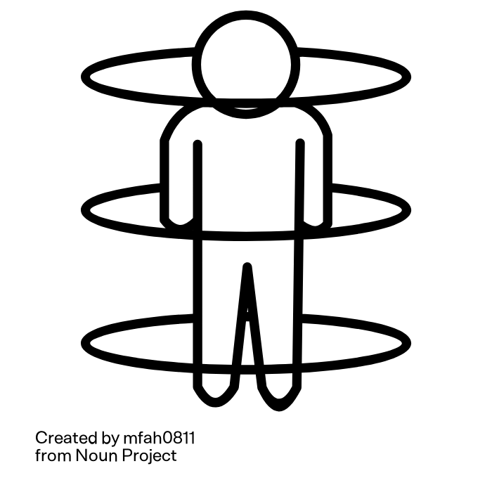
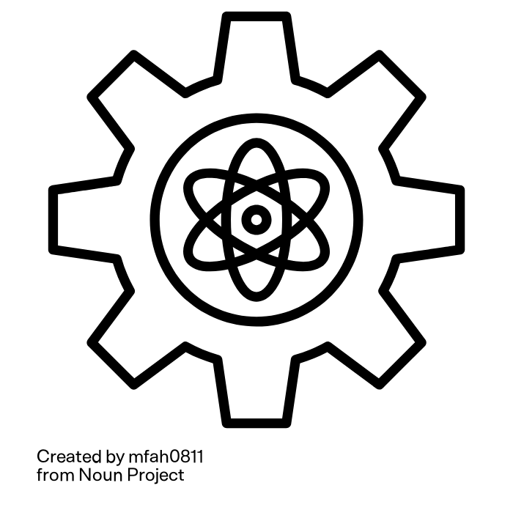
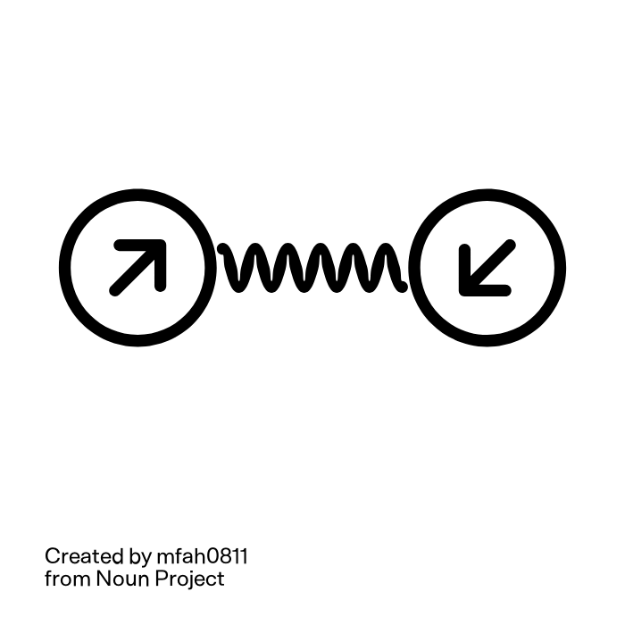
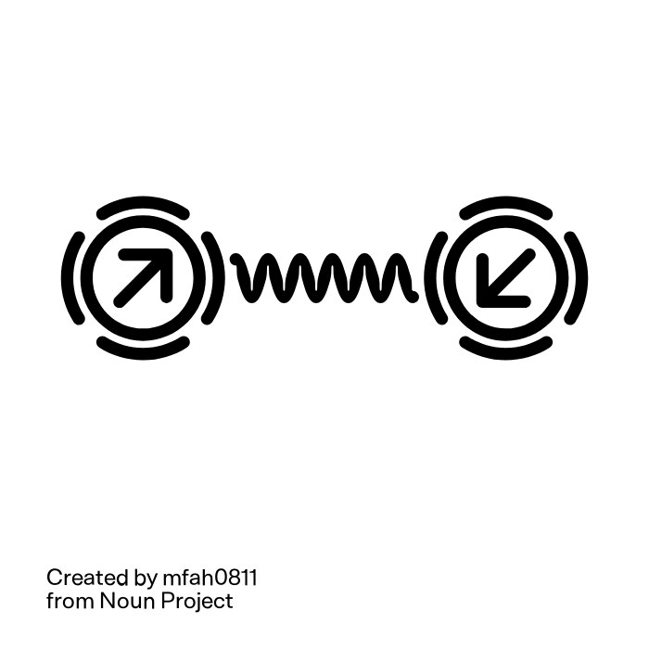
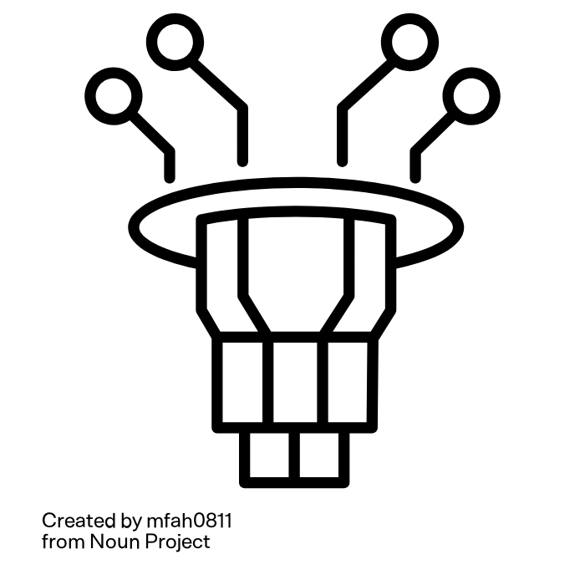
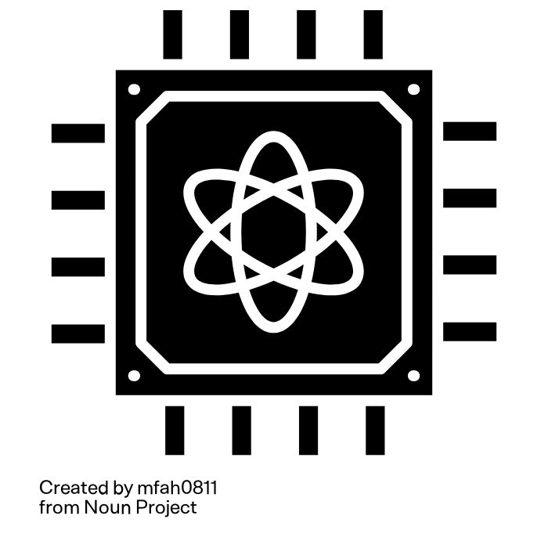

Motivation
Quantum Teleportation
Quantum Decoherence/noise
Quantum Error Correction

Slide 3
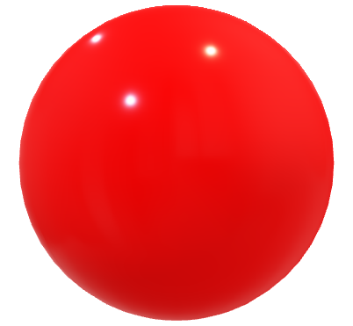
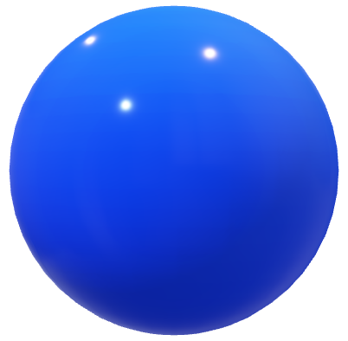
Quantum Noise
0
0
Bit Flip
Phase Flip
1
1
Amplitude Damping
Phase Damping
Fidelity decreases due to noises

Slide 4
Objectives
What happens when quantum teleportation goes through phase and amplitude dumping?
Can we quantify the choice of QECC with Quantum Discord and Entanglement of Information Metrics ?
How can we improve fidelity by employing QECC?
When to deploy which QECC?

Slide 5
What happens when quantum teleportation goes through phase and amplitude dumping?

Slide 6
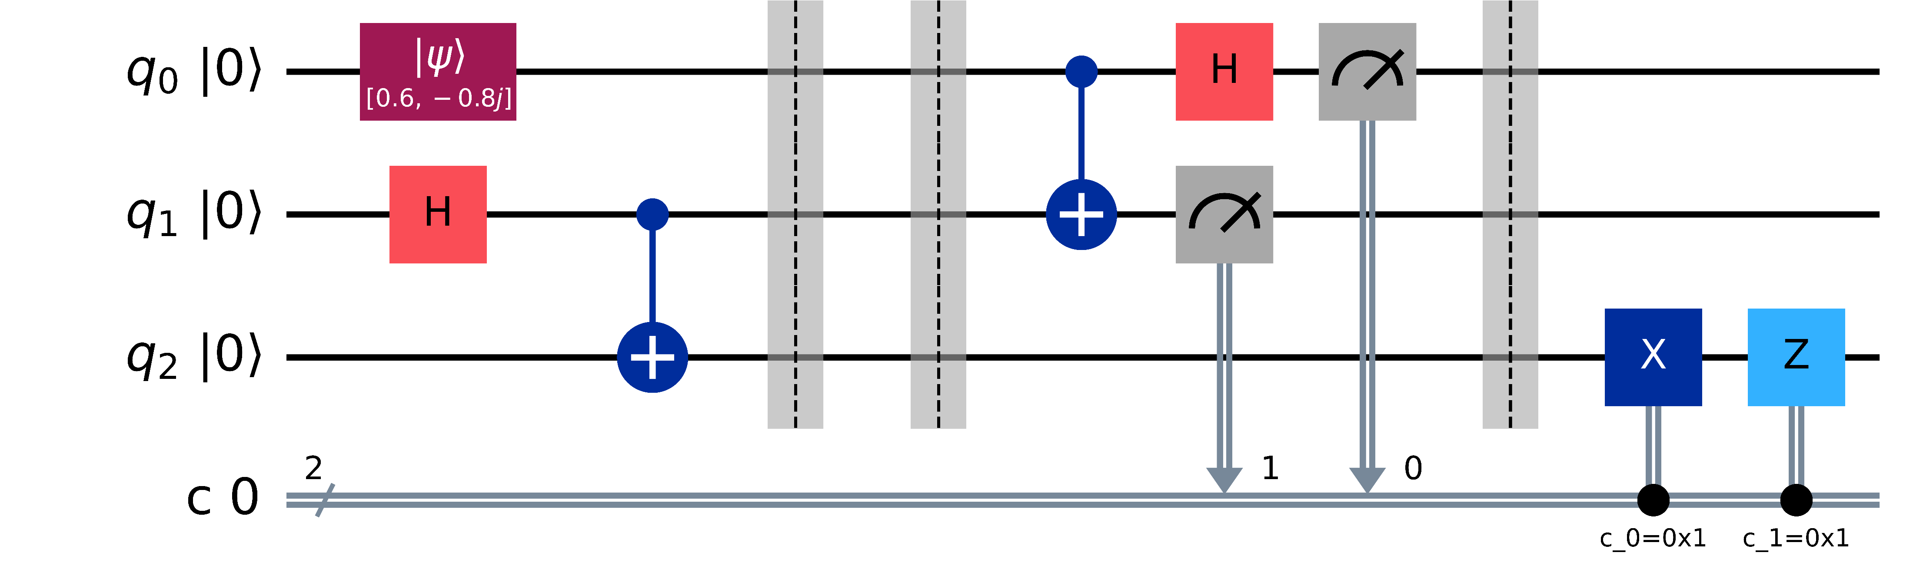
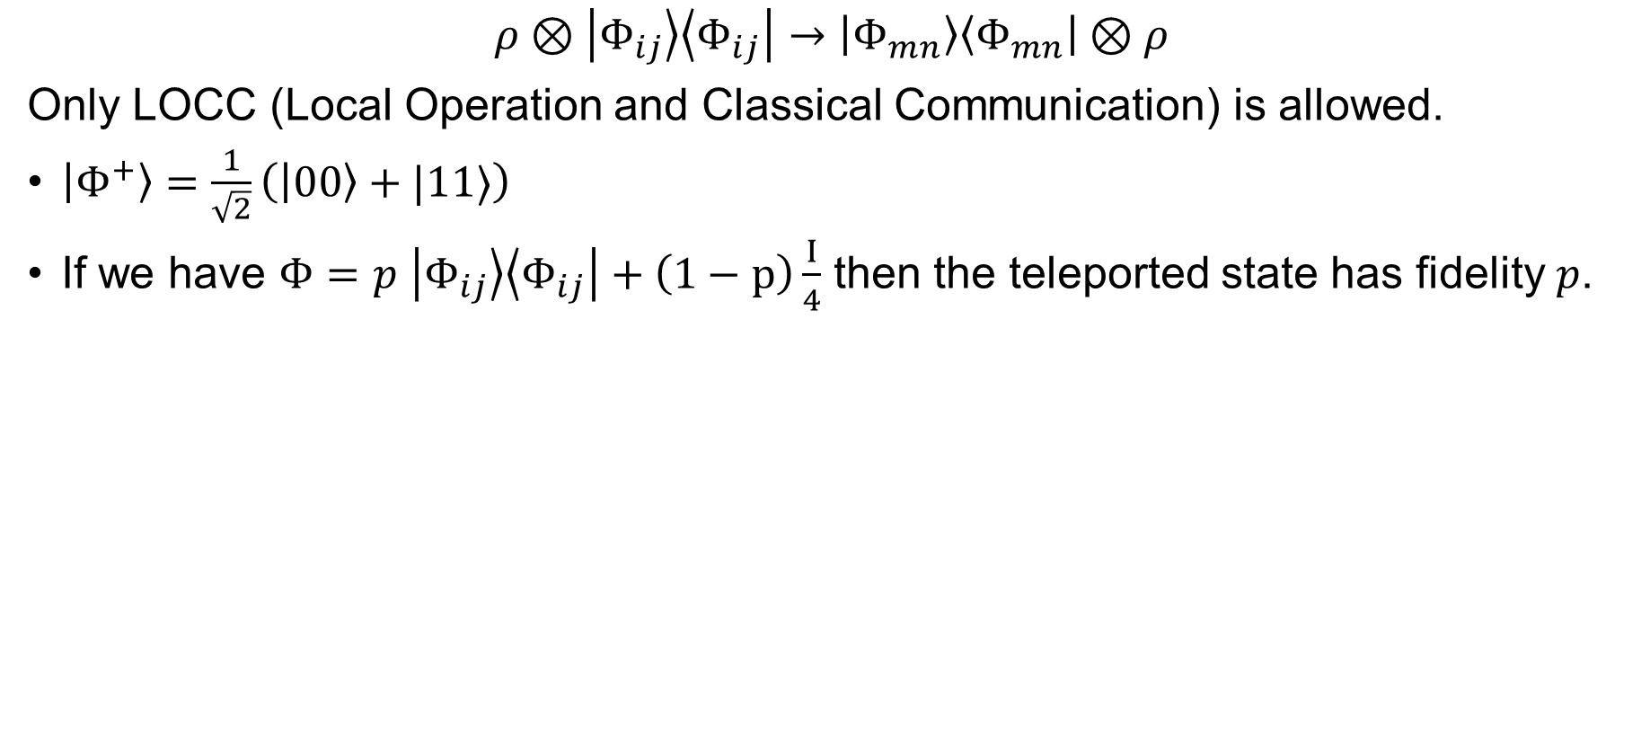
Quantum Teleportation
$$ρ⊗\left|Φ_{ij}\right\rangle \left\langle Φ_{ij}\right|→\left|Φ_{mn}\right\rangle \left\langle Φ_{mn}\right|⊗ρ$$
Only LOCC (Local Operation and Classical Communication) is allowed.
$\left|Φ^{+}\right\rangle =\frac{1}{\sqrt{2}}\left(\left|00\right\rangle +|11⟩\right)$
If we have $Φ=p$ $\left|Φ_{ij}\right\rangle \left\langle Φ_{ij}\right|+\left(1−p\right)\frac{I}{4}$ then the teleported state has fidelity $p$.

Slide 7
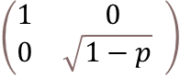
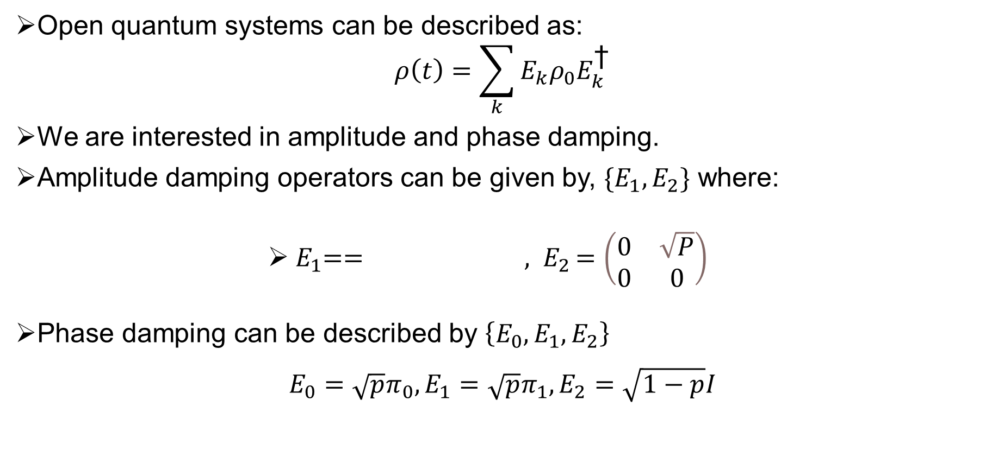
Mathematical Representation of Quantum Noise
Open quantum systems can be described as:
$$ρ\left(t\right)=\sum_{k}{E_{k}ρ_{0}E_{k}^{\text{†}}}$$
We are interested in amplitude and phase damping.
Amplitude damping operators can be given by, $\{E_{1},E_{2}\}$ where:
${ E}_{1}== {, E}_{2}=\left(\begin{matrix}0 & \sqrt{P} \\ 0 & 0\end{matrix}\right)$
Phase damping can be described by $\left\{E_{0}, E_{1},E_{2}\right\}$
$${E_{0}=\sqrt{p}π_{0},E_{1}=\sqrt{p}π_{1},E}_{2}=\sqrt{1−p}I$$

Slide 8
Effect of Quantum Noise (Cont.)
Single qubit → Extend it to multi qubit system
If single qubit error is E={E1, E2,...Em} with Ei's being Krauss operators, then we extend it for n-qubit system as, M= E⊗E⊗...⊗E.
Now, there is two error channels M & N on whole with equal probability of happening. Modeling the error as their superposition:
K= (M○N + N○M)/2
with ○ being the composition of those two error channels.
In our case M, N have been obtained by extending both amplitude damping and phase damping channel.
0<=p<=1 is the parameter for Amplitude Damping.
0<=q<=1 is the parameter for Phase Damping.

Slide 9
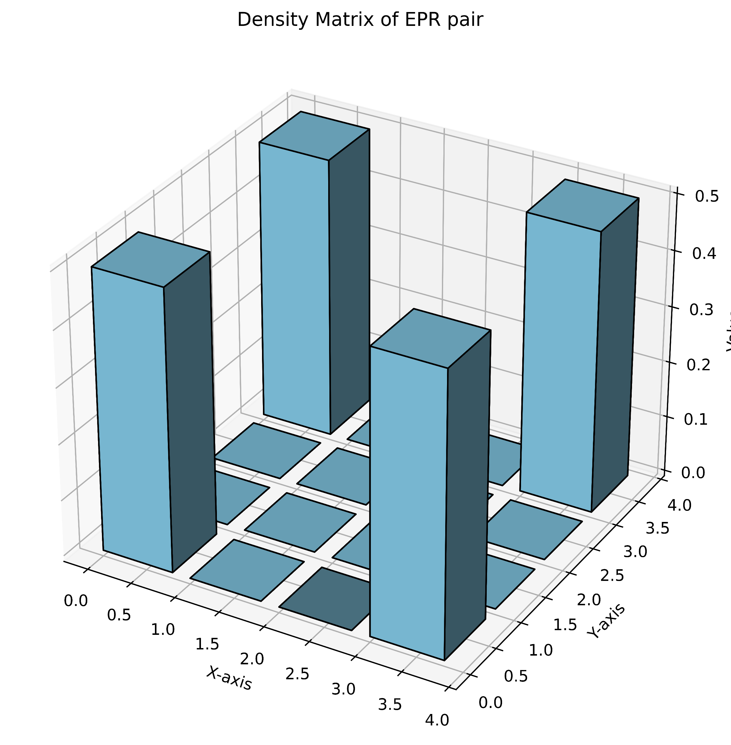
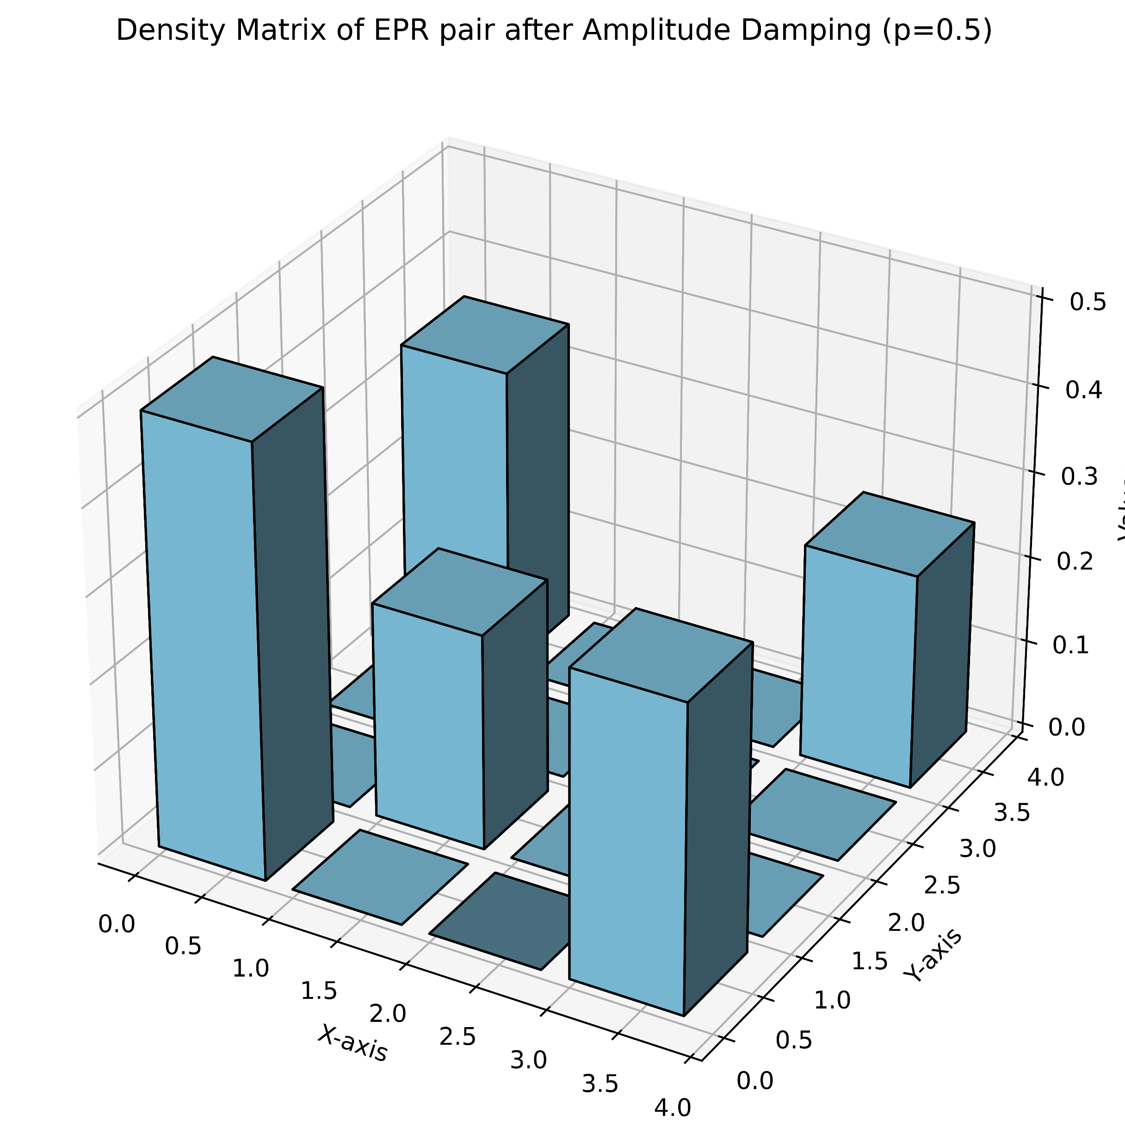
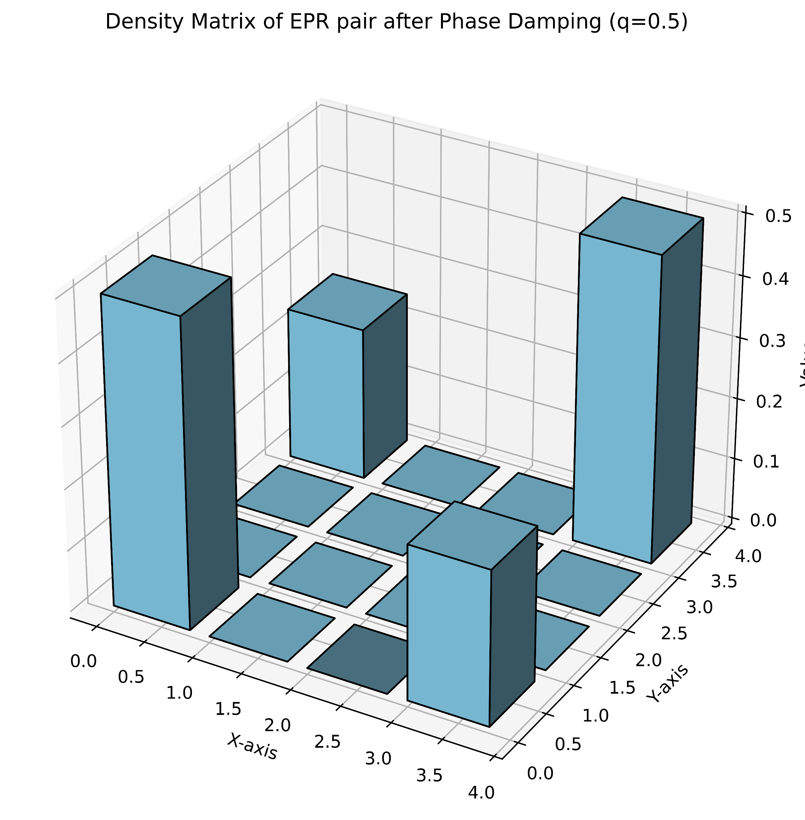
Density Matrix Histogram
Amplitude Damping (parameter: p) and ​ Phase Damping (parameter: q) on 1st Qubit of Bell pair​
Notes:
Please replace these graphs with nice graphs

Slide 10
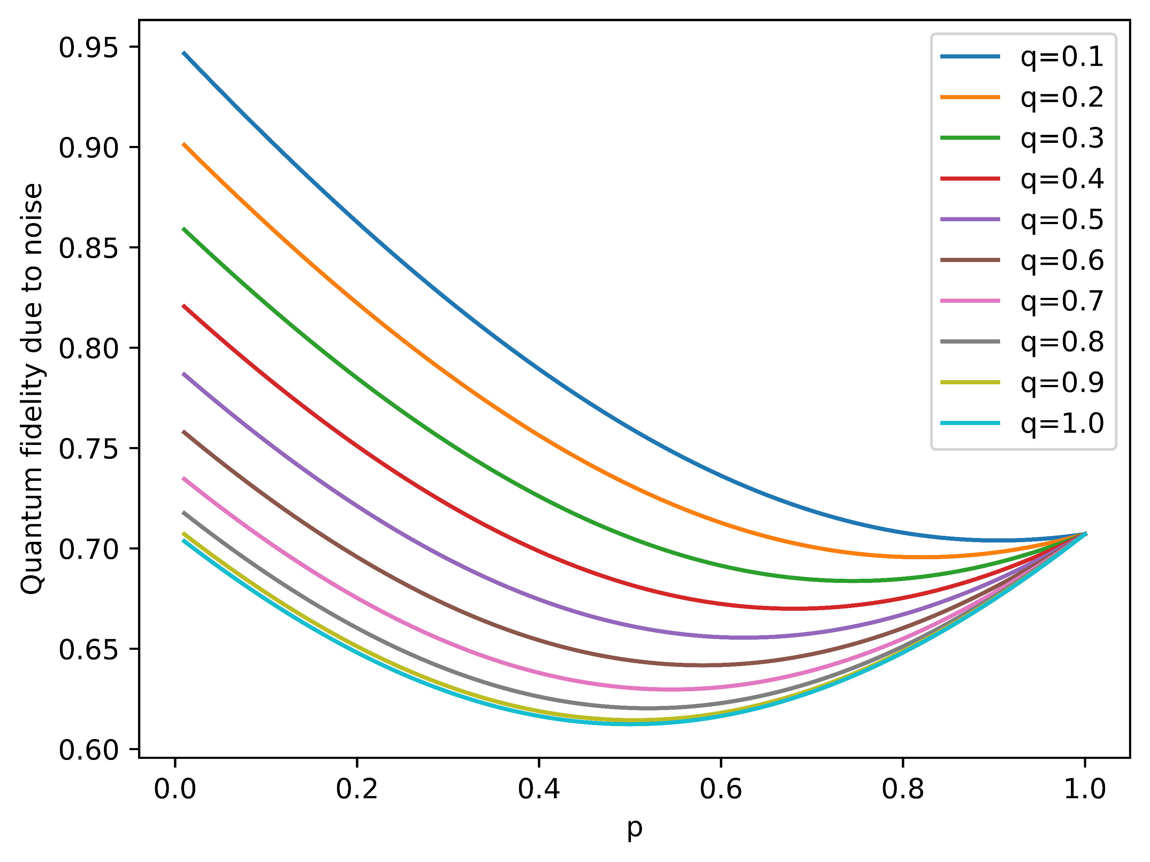
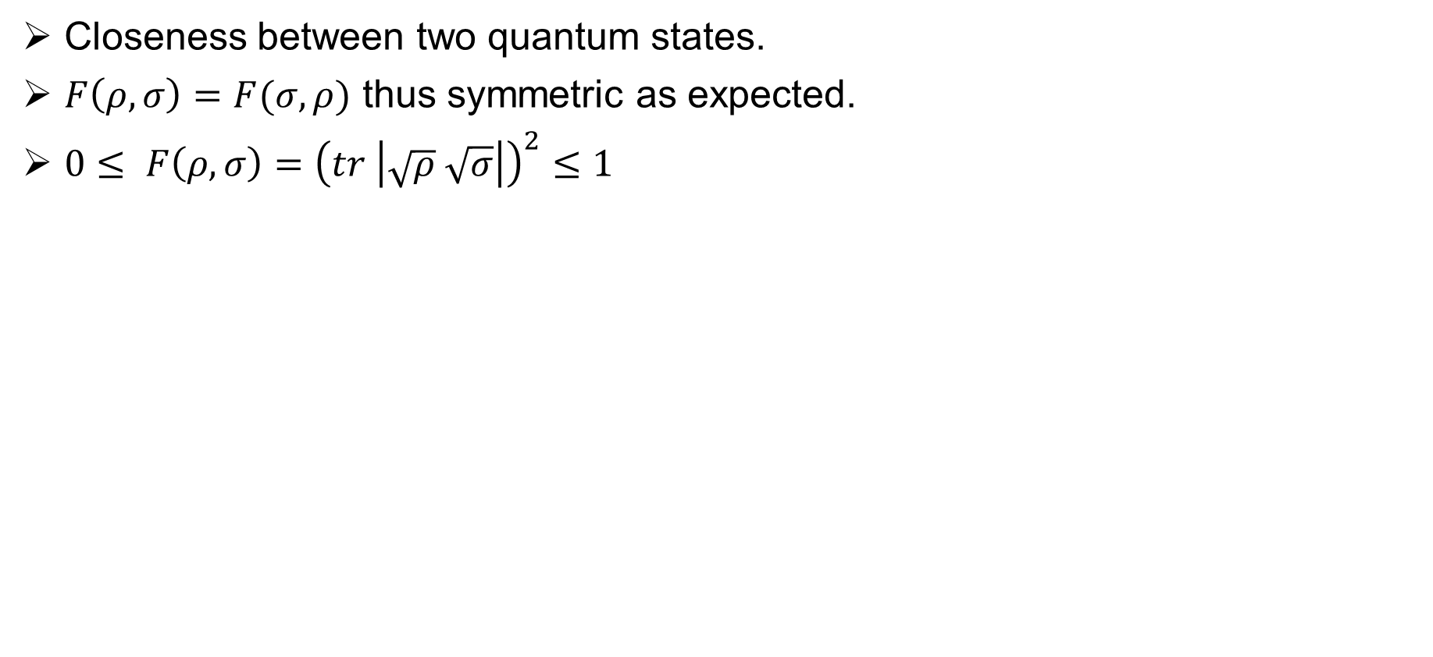
Fidelity
Closeness between two quantum states.
$F\left(ρ, σ\right)=F(σ,ρ)$ thus symmetric as expected.
$0≤ F\left(ρ, σ\right)={\left(tr \left|\sqrt{ρ} \sqrt{σ}\right|\right)}^{2}≤1$

Slide 11
Can we quantify the choice of QECC with Quantum Discord and Entanglement of Information Metrics ?

Slide 12
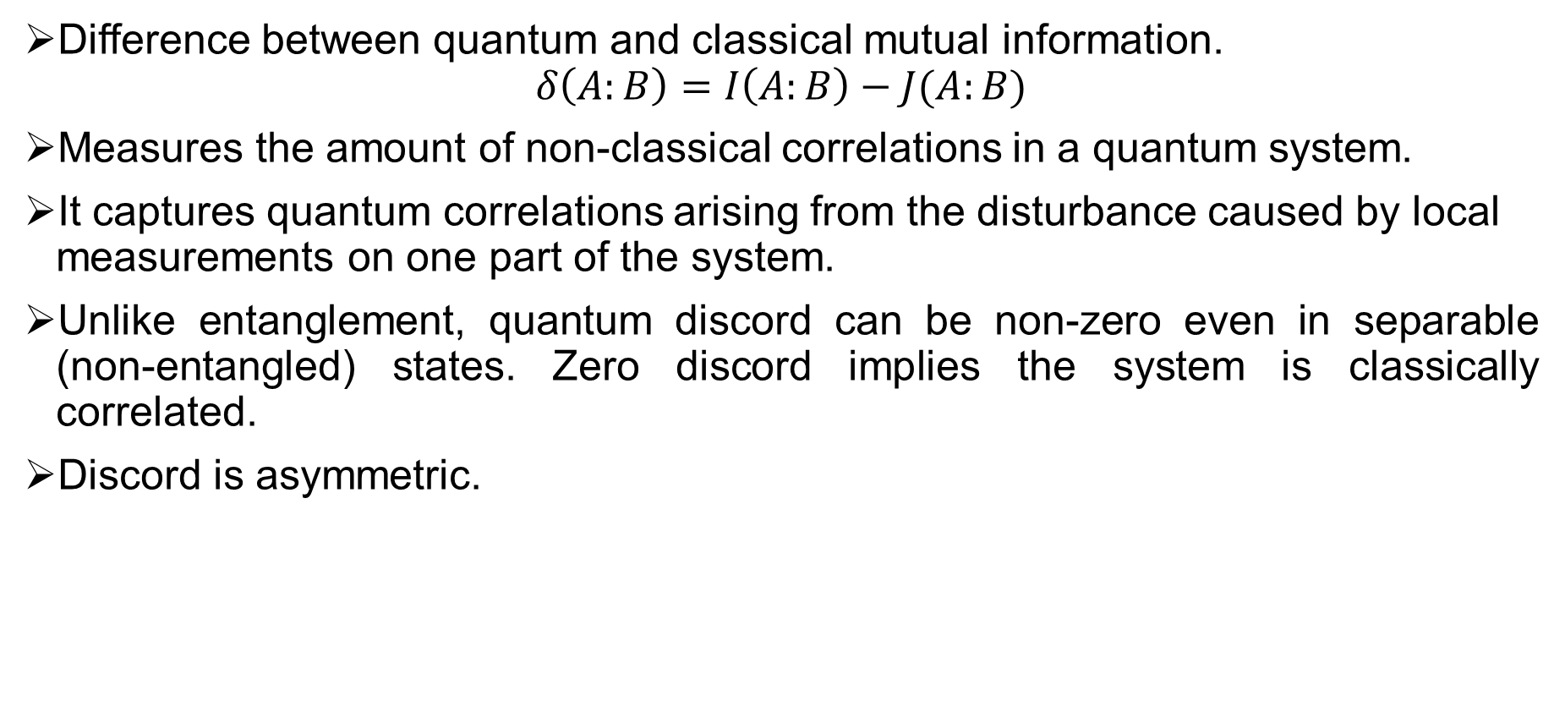
Quantum Discord (QD)
Difference between quantum and classical mutual information.
$$δ\left(A:B\right)=I\left(A:B\right)−J(A:B)$$
Measures the amount of non-classical correlations in a quantum system.
It captures quantum correlations arising from the disturbance caused by local measurements on one part of the system.
Unlike entanglement, quantum discord can be non-zero even in separable (non-entangled) states. Zero discord implies the system is classically correlated.
Discord is asymmetric.

Slide 13
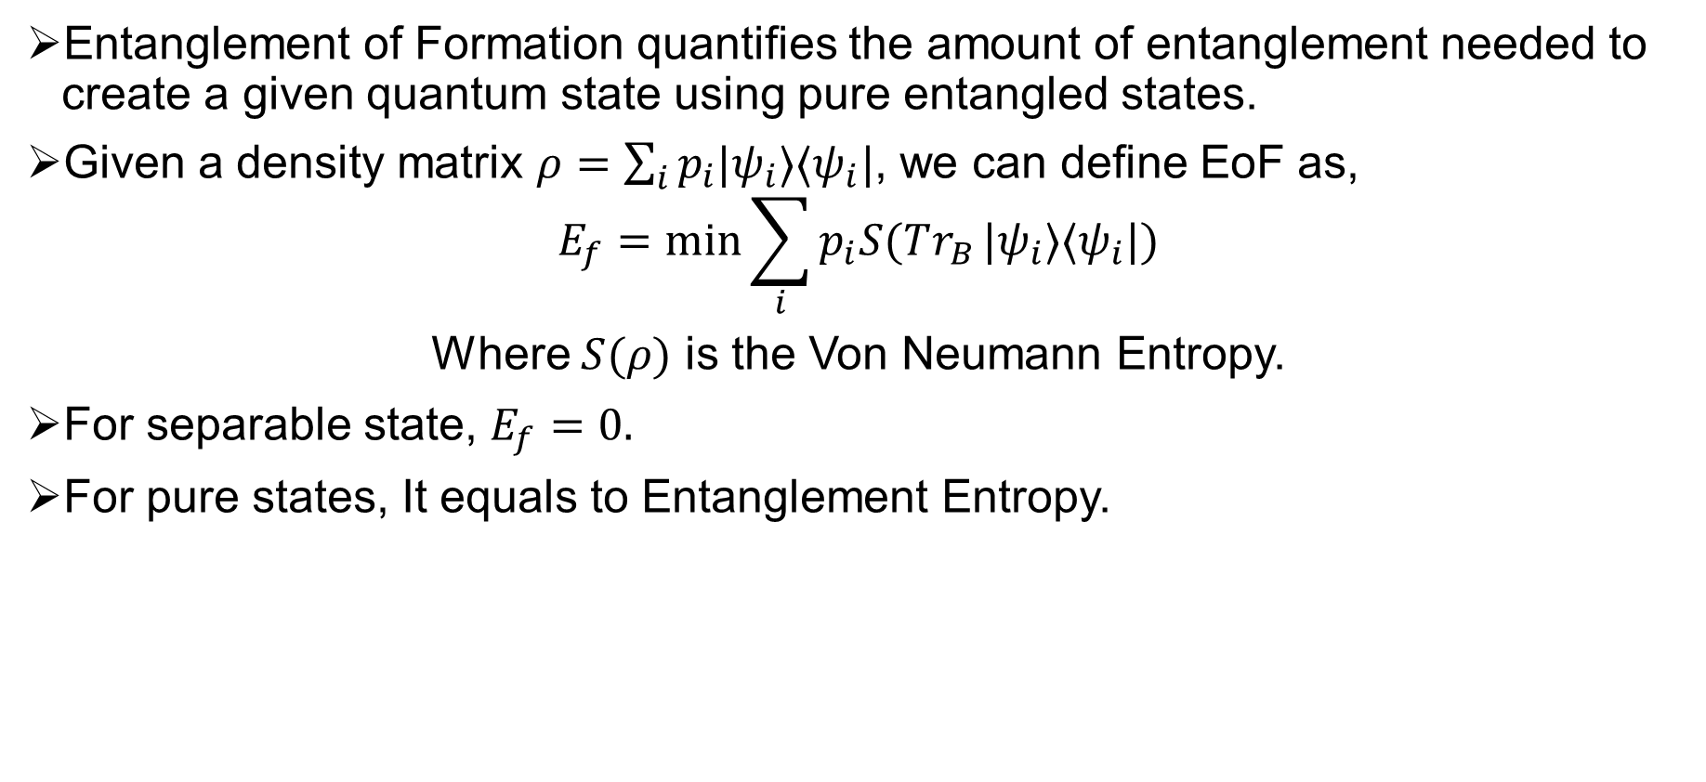
Entanglement of Formation (EoF)
Entanglement of Formation quantifies the amount of entanglement needed to create a given quantum state using pure entangled states.
Given a density matrix $ρ=\sum_{i}{p_{i}|ψ_{i}⟩⟨ψ_{i}|}$, we can define EoF as,
$$E_{f}=\min{\sum_{i}{p_{i}S(Tr_{B}}|ψ_{i}⟩⟨ψ_{i}|)}$$
Where $S(ρ)$ is the Von Neumann Entropy.
For separable state, $E_{f}=0.$
For pure states, It equals to Entanglement Entropy.

Slide 14
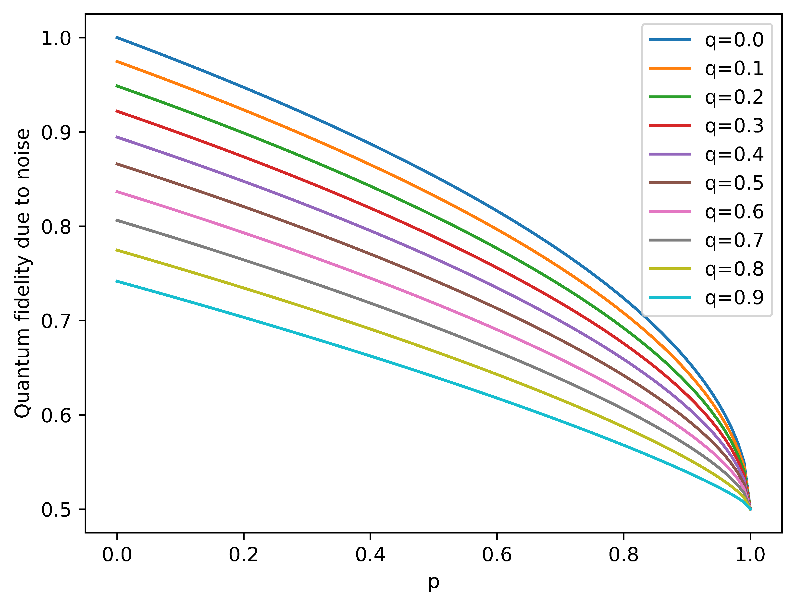
Our Model
Employing QECC is computationally expensive.
Hence, we tried applying noise to Alice’s side. It changed Fidelity!
Quantum Fidelity
p

Slide 15
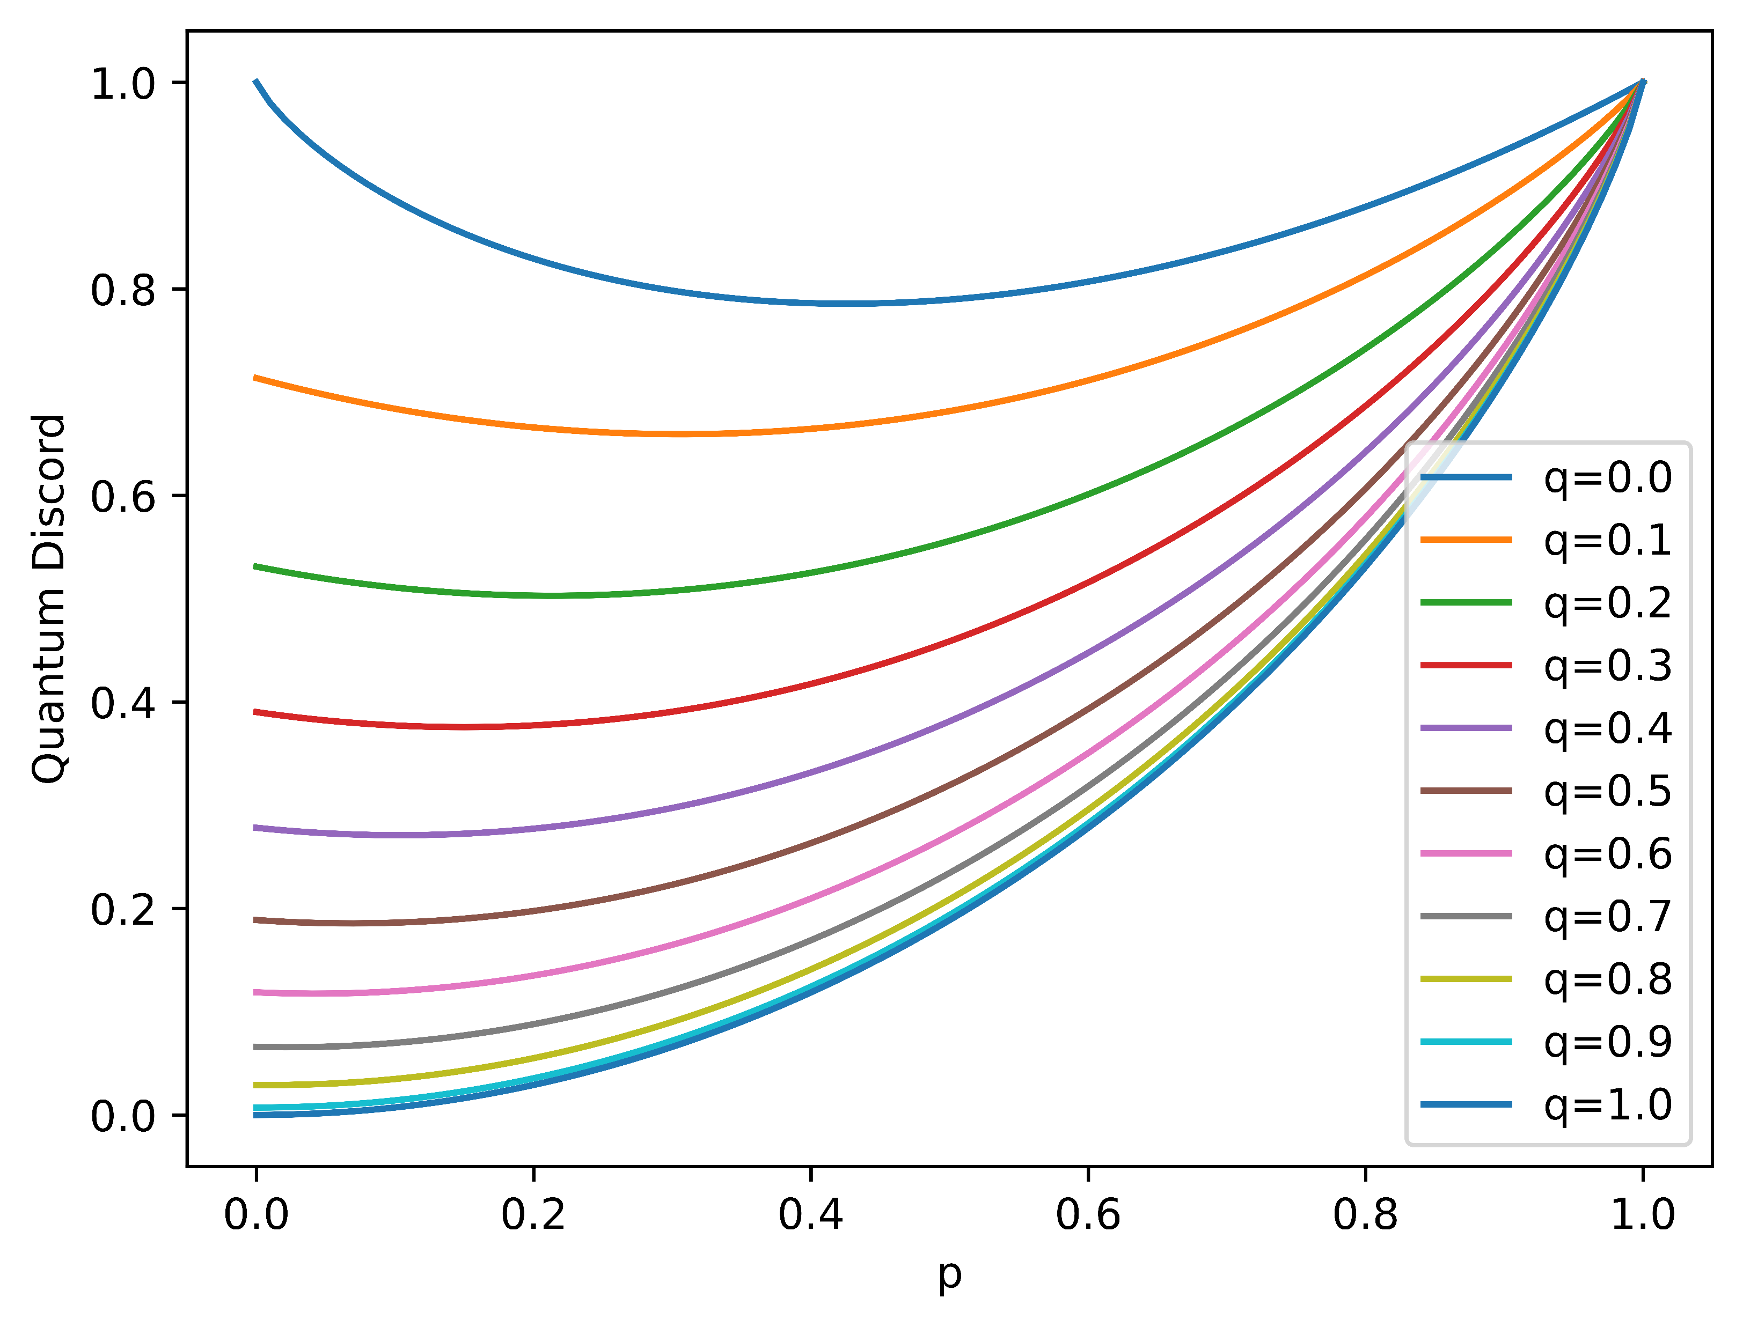
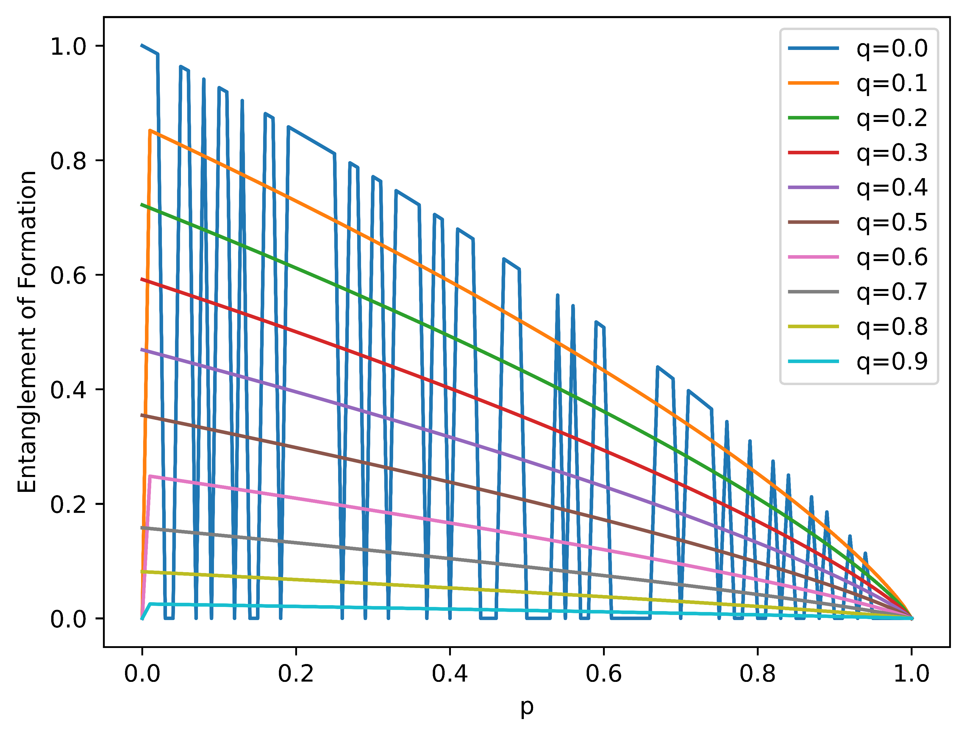
Simulation of QD and EoF (varying p, q)
Quantum Discord
Entanglement of Formation
Quantum Discord
Entanglement of Formation
p
p

Slide 16
How can we improve fidelity by employing QECC?

Slide 17
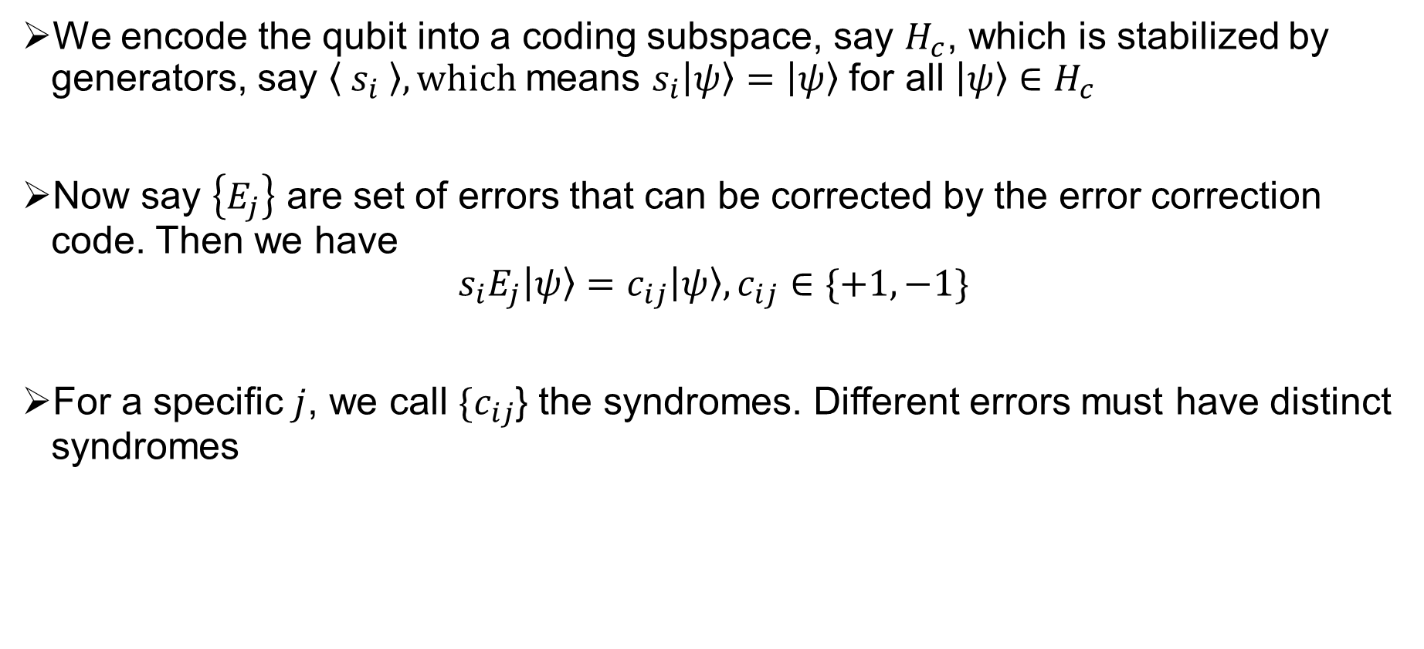
Stabilizer Code
We encode the qubit into a coding subspace, say $H_{c}$, which is stabilized by generators, say $\left\langle s_{i} \right\rangle , which$means $s_{i}\left|ψ\right\rangle =\left|ψ\right\rangle$ for all $\left|ψ\right\rangle ∈H_{c}$
Now say $\left\{E_{j}\right\}$ are set of errors that can be corrected by the error correction code. Then we have
$$s_{i}E_{j}\left|ψ\right\rangle =c_{ij}\left|ψ\right\rangle , c_{ij}∈\{+1, −1\}$$
For a specific $j$, we call $\{c_{ij}$} the syndromes. Different errors must have distinct syndromes

Slide 18
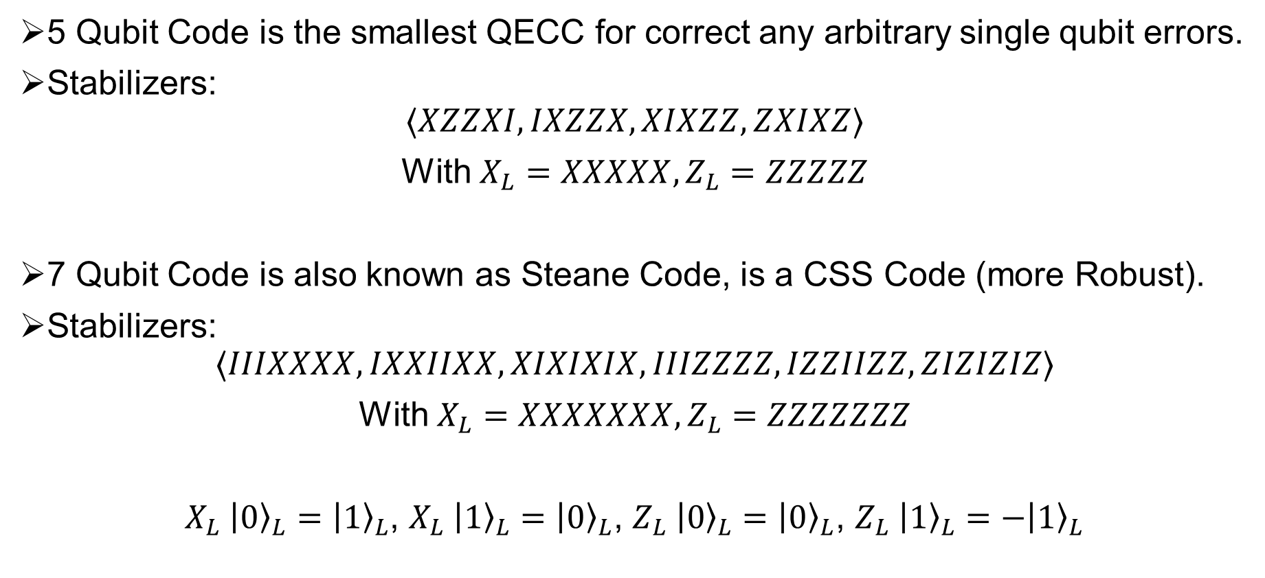
5 Qubit Code vs 7 Qubit Code
5 Qubit Code is the smallest QECC for correct any arbitrary single qubit errors.
Stabilizers:
$$⟨XZZXI, IXZZX,XIXZZ,ZXIXZ⟩$$
With $X_{L}=XXXXX, Z_{L}=ZZZZZ$
7 Qubit Code is also known as Steane Code, is a CSS Code (more Robust).
Stabilizers:
$$⟨IIIXXXX, IXXIIXX,XIXIXIX,IIIZZZZ, IZZIIZZ, ZIZIZIZ⟩$$
With $X_{L}=XXXXXXX, Z_{L}=ZZZZZZZ$
$X_{L} {\left|0\right\rangle }_{L}={\left|1\right\rangle }_{L}$, $X_{L} {\left|1\right\rangle }_{L}={\left|0\right\rangle }_{L}$, $Z_{L} {\left|0\right\rangle }_{L}={\left|0\right\rangle }_{L}$, $Z_{L} {\left|1\right\rangle }_{L}=−{\left|1\right\rangle }_{L}$

Slide 19
When to deploy which QECC?

Slide 20
Which code to use?
Low Eof, Low QD: Unusable
Low Eof, High QD: Preserve quantum residue: 5 Qubit Code?
High Eof, Low QD: Preserve entanglement: 7 Qubit Code?
High Eof, High QD: No QECC required!

Slide 21
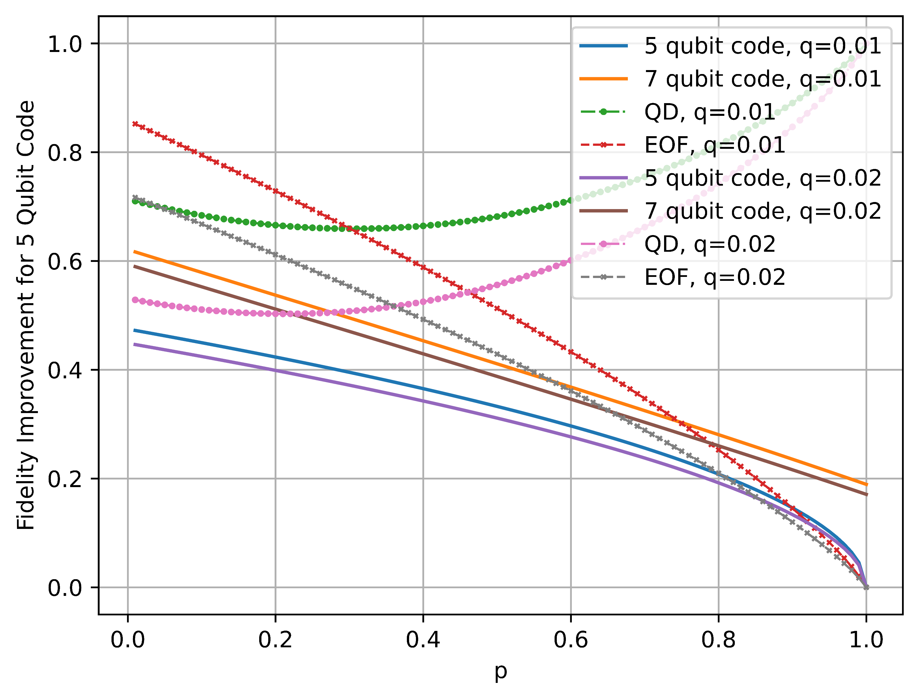
Experimental Result
0.4
0.6
0.4
0.4
0.6
0.6
0.6
0.6
Fidelity Improvement
p

Slide 22
Future Works
Completing the simulation to confirm hypothesis.
Extending the simulation to for more realistic modelling.
Reducing computational complexity.
Exploring more QECC alternatives.

Slide 23
THANK YOU!
Any Questions?

